Slide 1


Airline Profitability Analysis
The airline operates a diverse aircraft fleet ranging from small business jets to medium-sized machines. They have been providing high-quality air transportation services to their clients for several years, and our primary focus is to ensure a safe, comfortable, and convenient journey for our passengers we are currently facing challenges due to several factors such as stricter environmental regulations, higher flight taxes, increased interest rates, rising fuel prices, and a tight labor market resulting in increased labor costs.
by Tanmoy Guria

Slide 2

Challenges Facing the Airline Industry
1
Stricter Environmental Regulations
2
Higher Flight Taxes
3
Tight Labor Market
To solve environmental issues and increase money, governments all around the world are taxiing aircraft more heavily, which raises the cost of flying and decreases demand.
The lack of trained people in the aviation sector has increased labor costs and increased turnover rates.
The demand on the airlines industry to decrease its carbon footprint is growing, which has resulted in more stringent environmental laws that raise operating costs and restrict expansion potential.

Slide 3

Objectives for Improvement
Increase Occupancy Rate
By increasing the occupancy rate, we can boost the average profit earned per seat and mitigate the impact of the challenges we're facing.
Improve Pricing Strategy
We need to develop a pricing strategy that takes into account the changing market conditions and customer preferences to attract and retain customers.
Enhance Customer Experience
We need to focus on providing a seamless and convenient experience for our customers, from booking to arrival, to differentiate ourselves in a highly competitive industry and increase customer loyalty.

Slide 4
Aircraft Seating Capacity
Aircraft Code | Number of Seats
319 | 116
320 | 140
321 | 170
733 | 130
763 | 222
773 | 402

Slide 5

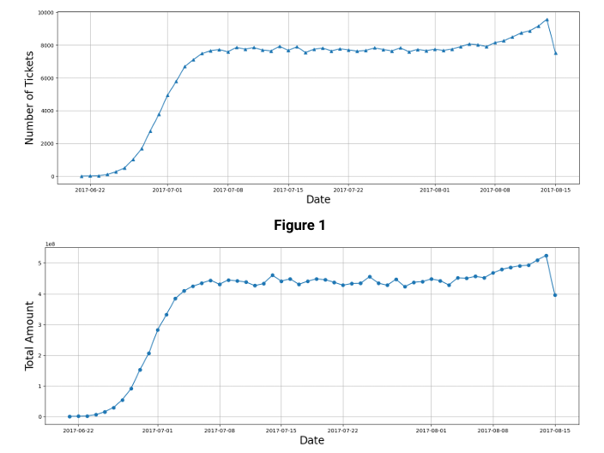
Ticket Booking Insights
1
June 22 - July 7
Consistent growth in bookings.
2
July 7 - July 14
Stable bookings with a significant peak.
3
Revenue Patterns
Closely reflects ticket bookings.

Slide 6

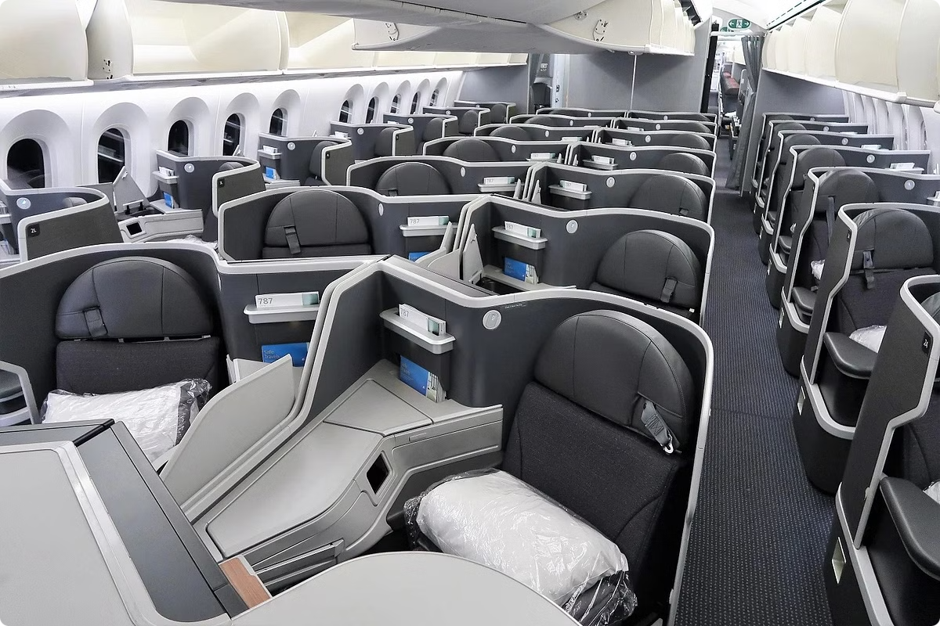
Fare Analysis
Class
Aircraft
Fare
Business
All
Highest
Comfort
773
Mid-range
Economy
All
Lowest

Slide 7

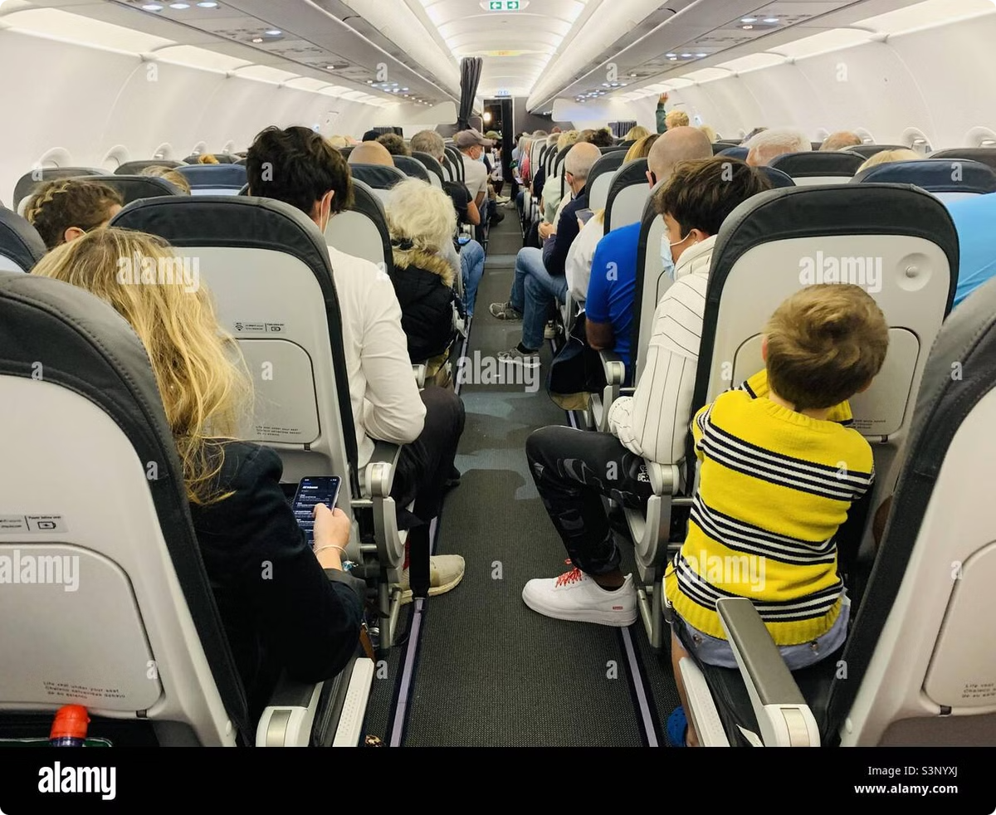
Occupancy Rates
1
Occupancy Rate Analysis
Evaluates how effectively seats are filled.
2
Potential Revenue Growth
Illustrates impact of increasing occupancy.
3
10% Increase in Occupancy
Significant revenue boost potential.

Slide 8


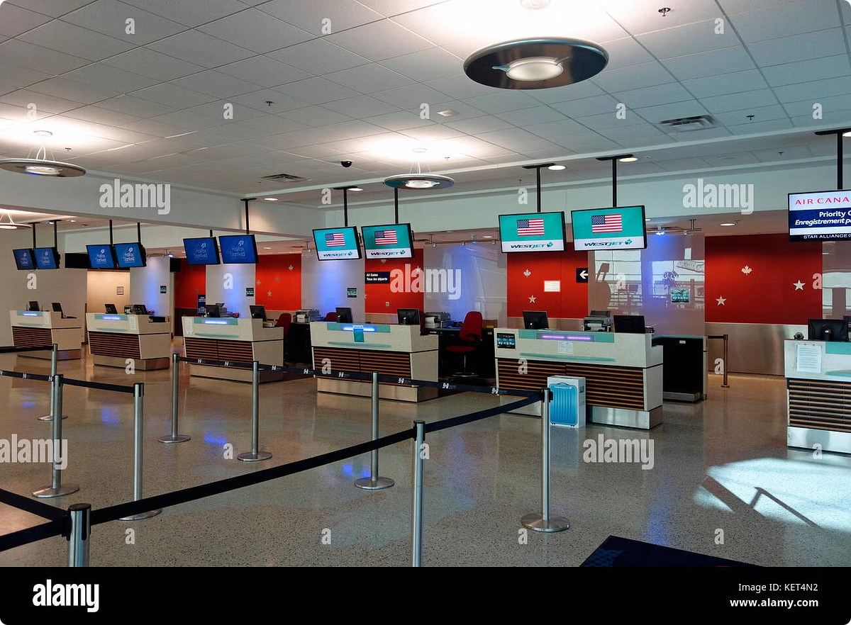


Pricing Strategy
Lower Fares
Attract more passengers on less popular routes.
Adjust Excessive Fares
Optimize pricing to align with market demand.
Increase Occupancy
Maximizing passenger capacity and revenue.

Slide 9


Analyzing Occupancy Rate
This part of presentation analyzes the occupancy rate of an airline, focusing on how efficiently seats are filled on each aircraft and exploring the potential revenue impact of increasing occupancy.

Slide 10
Occupancy Rate Metrics
Booked Seats
Occupancy Rate
Empty Seats
This analysis examines the average number of booked seats per aircraft to understand how successfully the airline fills its available seats.
The occupancy rate is calculated by dividing the number of booked seats by the total available seats in each aircraft.
The analysis explores the number of empty seats per flight to identify opportunities for improving seat utilization.
Analyze historical data to identify trends in booked seats.
Identify factors influencing occupancy rate fluctuations, such as seasonality and economic conditions.
Analyze the reasons behind empty seats, including cancellations, overbookings, and no-shows.
Compare booked seats across different aircraft types and flight routes.
Benchmark against industry averages and competitors to understand relative performance.
Develop strategies to minimize empty seats through effective inventory management and pricing.

Slide 11



Revenue Impact of Occupancy
Aircraft Code | Total Revenue | Ticket Count | Avg. Revenue per Ticket
319 | 2,706,163,100 | 52,853 | 51,201
321 | 1,638,164,100 | 107,129 | 15,291
733 | 1,426,552,100 | 86,102 | 16,568
763 | 4,371,277,100 | 124,774 | 35,033
773 | 3,431,205,500 | 144,376 | 23,765
CN1 | 96,373,800 | 14,672 | 6,568
CR2 | 1,982,760,500 | 150,122 | 13,207
SU9 | 5,114,484,700 | 365,698 | 13,985
Higher Occupancy
Increased Revenue
Reduced Costs
Higher occupancy rates directly translate to increased revenue and profitability for the airline.
With more passengers filling the seats, the airline generates more revenue from ticket sales.
Lower operational costs are associated with empty seats, such as fuel consumption and maintenance.

Slide 12

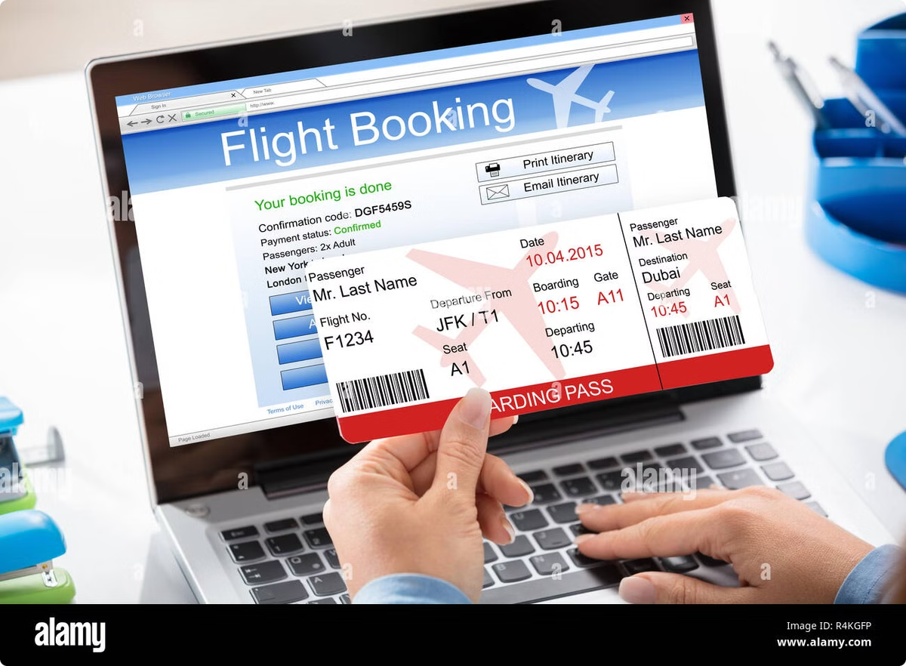
Influencing Factors
1
Pricing Strategy
The airline's pricing strategy plays a crucial role in attracting passengers and filling seats. Competitive pricing and fare adjustments are essential to maximize occupancy.
2
Airline Schedules
Flight schedules, including frequency, timing, and route network, influence passenger demand and ultimately impact occupancy rates.
3
Customer Satisfaction
Positive customer experiences and high levels of satisfaction lead to repeat business and encourage passengers to recommend the airline.
4
Operational Efficiency
Smooth operations, on-time departures, and efficient baggage handling contribute to a positive passenger experience and improve occupancy rates.

Slide 13
Modeling a 10% Increase in Occupancy
Aircraft Code | Booked Seats | Num Seats | Occupancy Rate | Inc Occupancy Rate | Total Annual Turnover
319 | 53.58318099 | 116 | 0.461923974 | 0.5081163714 | 2976779410
321 | 88.80923077 | 170 | 0.5224072398 | 0.5746479638 | 1801980510
733 | 80.25546218 | 130 | 0.6173497091 | 0.67908468 | 1569207310
763 | 113.9372937 | 222 | 0.5132310528 | 0.5645541581 | 4808404810
773 | 264.9258065 | 402 | 0.659019419 | 0.7249213609 | 3774326050
CN1 | 16.00443131 | 12 | 0.5003692762 | 0.5504062038 | 106011180
CR2 | 21.4828469 | 50 | 0.429656938 | 0.4726226318 | 2181036550
SU9 | 56.81211268 | 97 | 0.5856918833 | 0.6442610716 | 5625933170
The analysis models a 10% increase in occupancy rates and demonstrates the potential for significant revenue growth. This suggests that the airline should focus on strategies to raise occupancy, such as optimizing pricing, improving operational efficiency, and enhancing customer experience.

Slide 14

Conclusion
Analyzing revenue data such as total revenue per year, average revenue per ticket, and average occupancy per aircraft is critical for airlines seeking to maximize profitability. Airlines can find areas for improvement and modify their pricing and route plans as a result of assessing these indicators.

